Slide 1

AIML CA2 Part A
LIM JUN YI
P2308924
DAAA/FT/1B/03

Slide 2
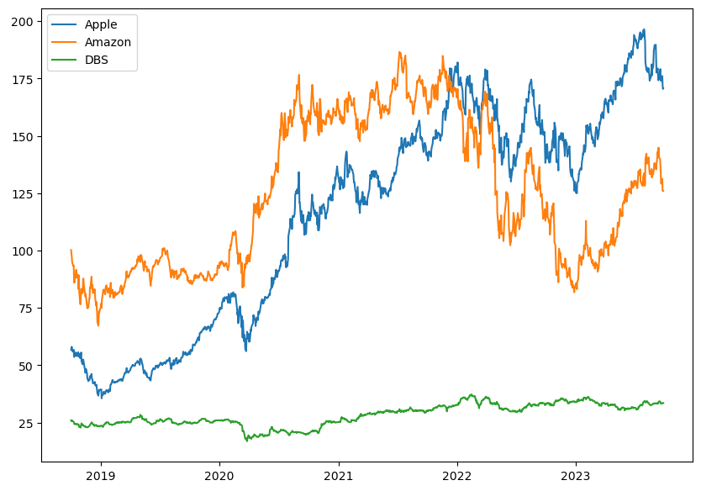
Aim of Part A
- To forecast the stock prices for the next 60 days
- Stocks: Amazon, Apple & DBS

Slide 3
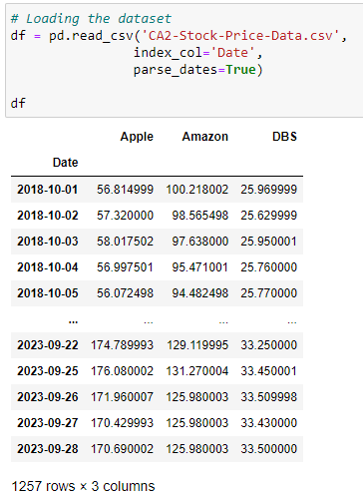

1. Preprocessing
- Loading the dataset given
- Visualizing the data

Slide 4
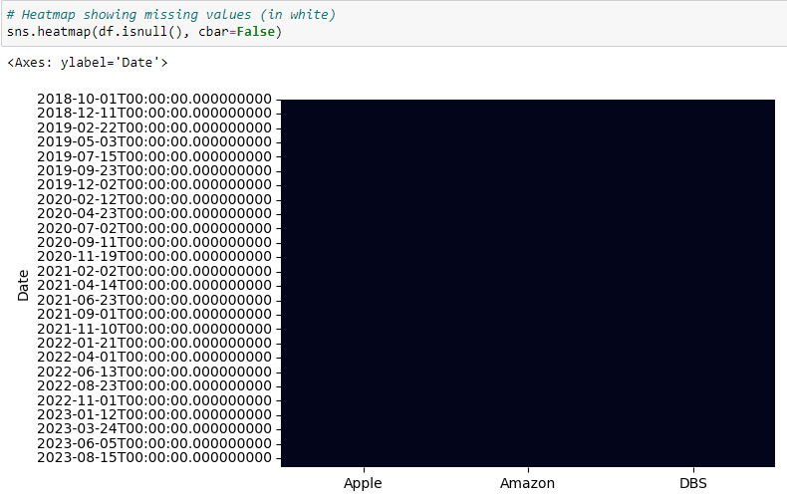
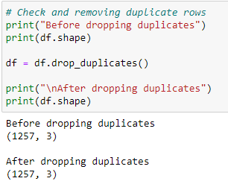
Dropping any duplicates
if present
Checking for missing values in the dataset

Slide 5
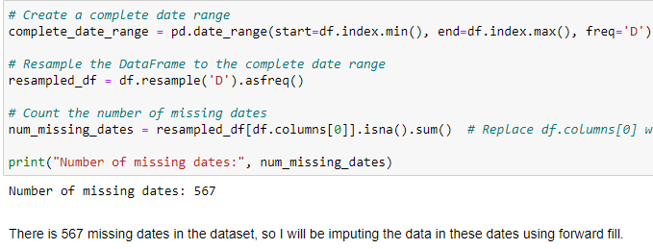
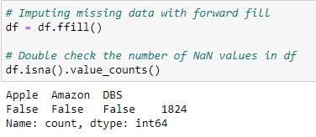
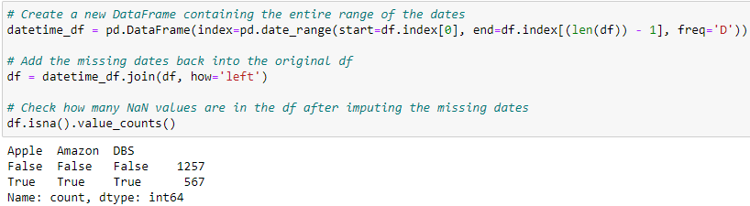
Check for missing dates:
567 missing dates → stock market don’t operate during the weekends
Impute values for missing dates:
Apply Forward-Fill as it takes the values from the previous day instead of the future
Add the missing dates into the original dataset

Slide 6
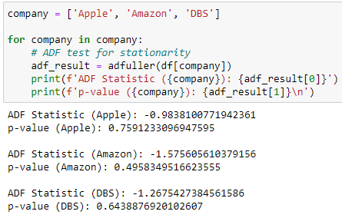
Test for white noise (ADF Test)
H0 : The series is non-stationary
H1 : The series is stationary
As all 3 p-values are larger than 0.05, I CANNOT reject the null hypothesis of non-stationarity. Thus, concluding that they are non-stationary.
They need to be transformed into stationary time series.

Slide 7
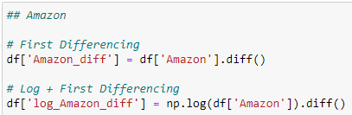
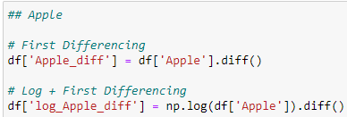
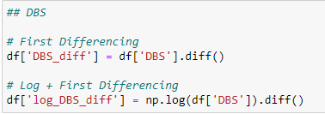
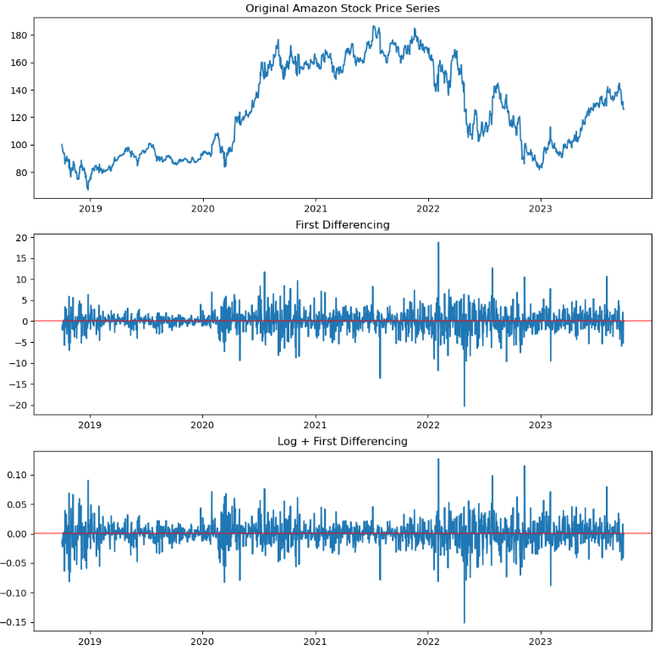
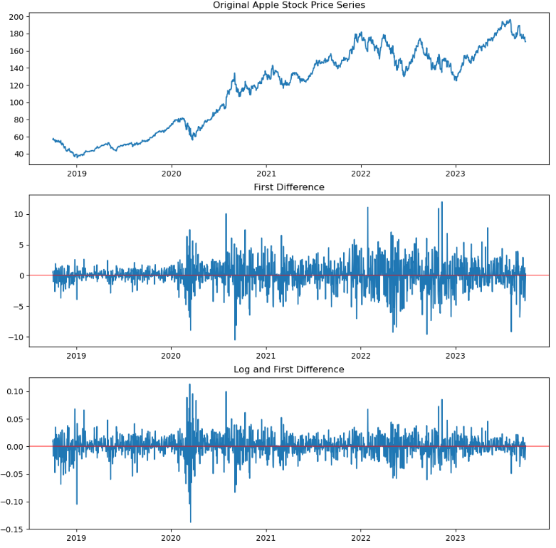
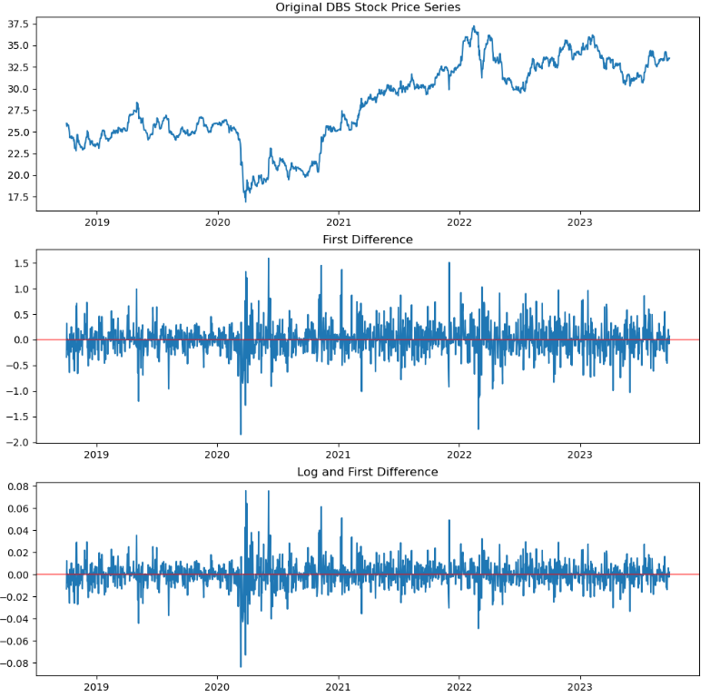
Transforming to Stationary timeseries
Applying 1st Differencing, Log + 1st Differencing to all 3 stock data to transform the Non-Stationary Series to Stationary series

Slide 8
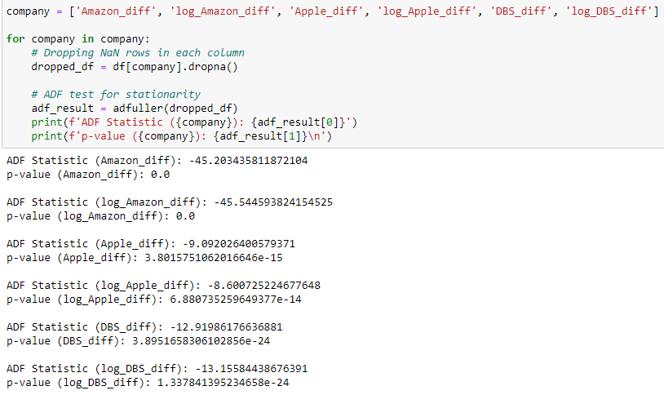
Test for white noise (ADF Test) v2
Perform the ADF Test on all 1st differenced and log + 1st differenced data.
* H0 : The series is non-stationary
* H1 : The series is stationary
As p-value is smaller than 0.05, reject the null hypothesis of non-stationarity, in favour of stationarity.
Thus, it can be concluded that the series is stationary.

Slide 9
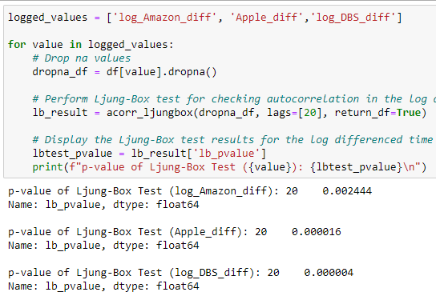
Ljung-Box
Since the p-value is low (< 0.05) for all 3 data,
→ Reject the H0 of zero autocorrelations
→ Conclude that the series is non-white noise.

Slide 10
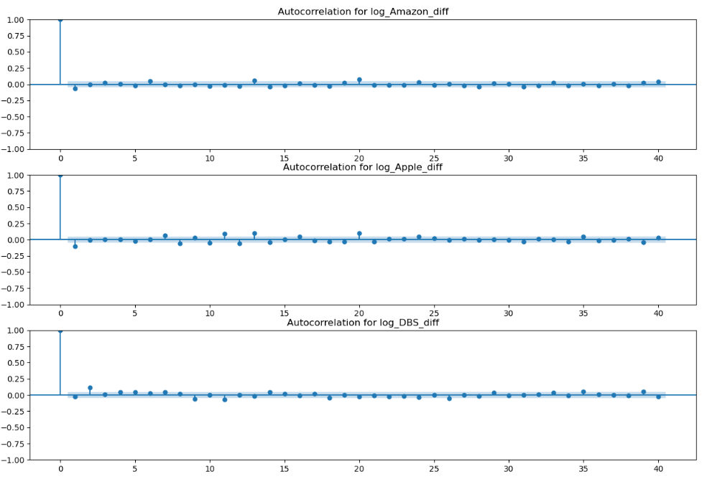
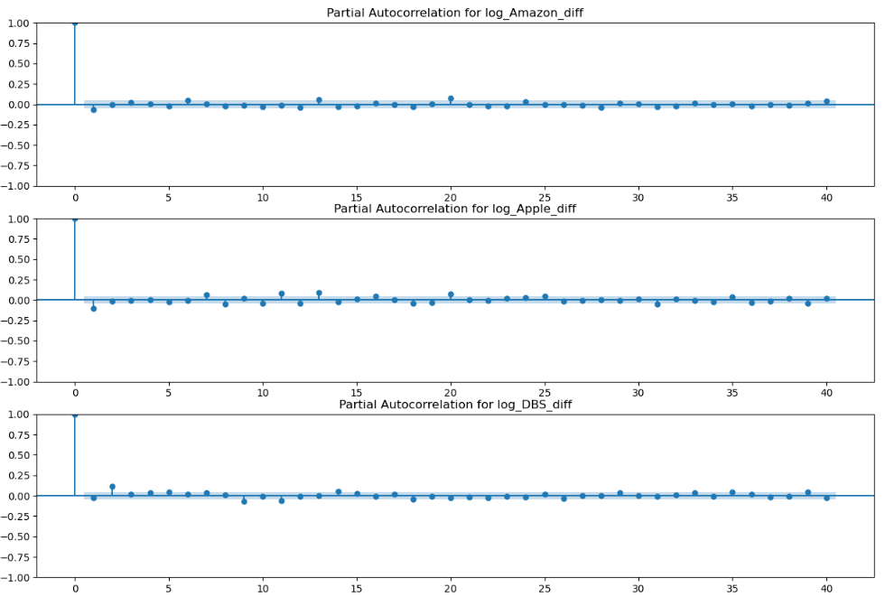
ACF Plot + PACF Plot
After plotting both the ACF and PACF plots, there are no significant spikes appearing in the plots, thus it doesn’t give any information on what the best parameters can be placed into the model.

Slide 11
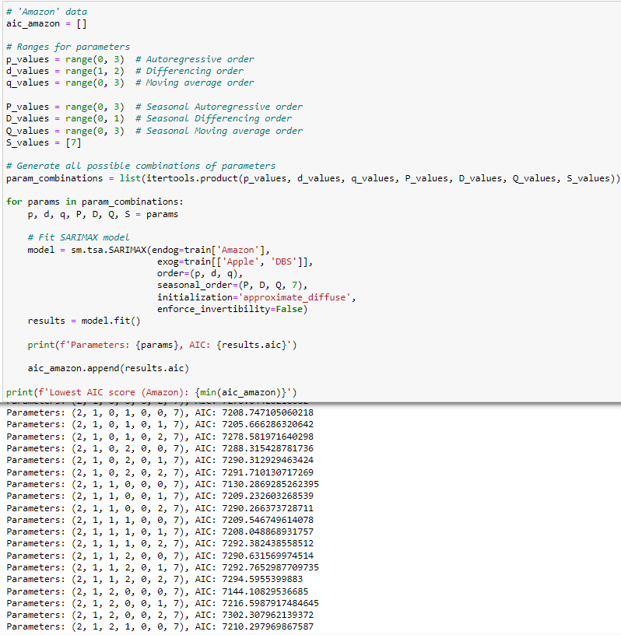
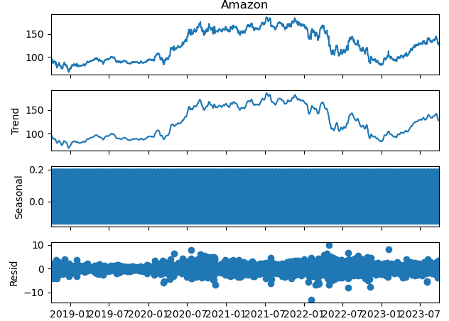
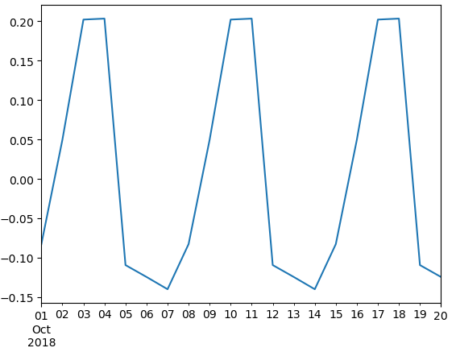

2. Modelling (Amazon)
Tuning the hyperparameters of SARIMAX
After zooming into the seasonal plot, it can be identified there is a seasonal trend of 7 days.
Since there is a seasonal trend of 7 days, it’s best to use SARIMAX

Slide 12
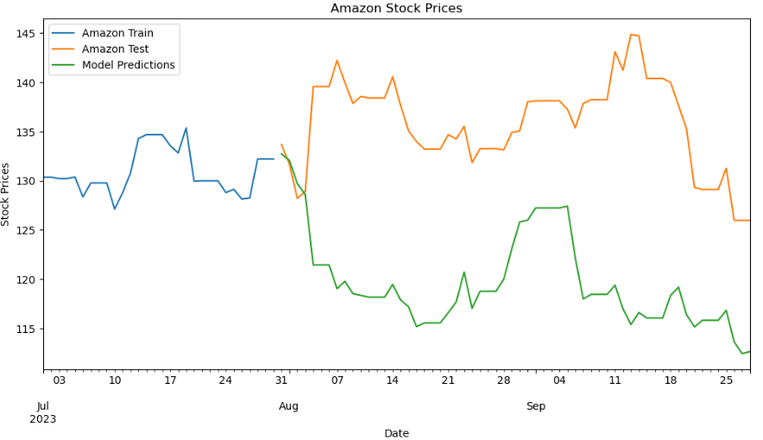
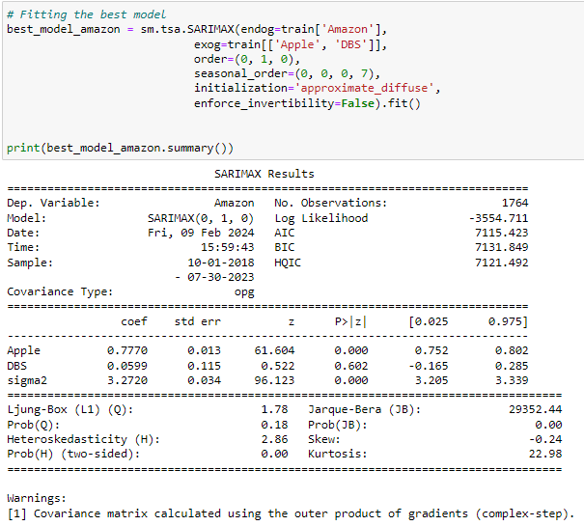
Amazon
Model’s prediction:
Ljung-Box test: High p-value (> 0.05) → fails to reject H0 of no autocorrelations → the residuals are white-noise
Heteroskedasticity test: High p-value (> 0.05) → fail to reject H0 of homoscedasticity → i.e. residuals are homoscedastic

Slide 13
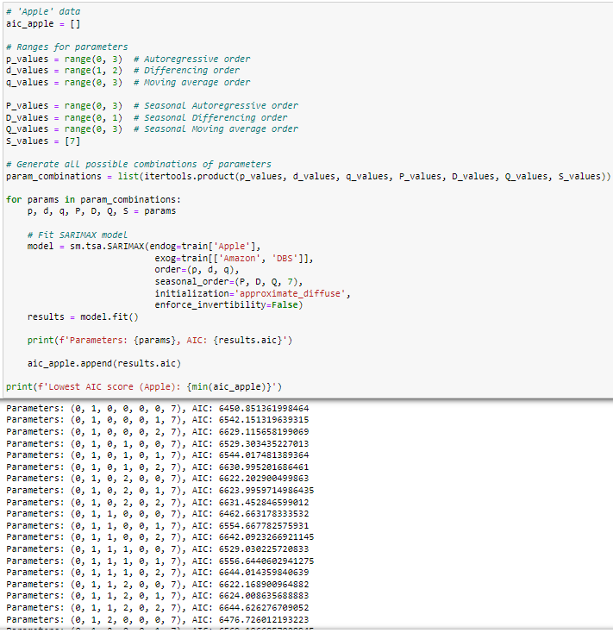
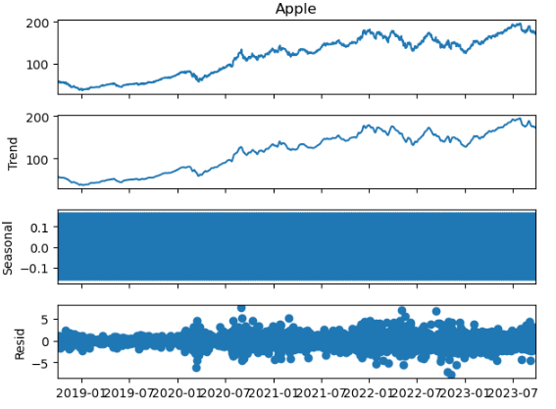
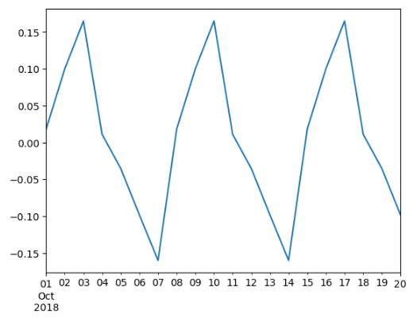

Apple
Tuning the hyperparameters of SARIMAX
After zooming into the seasonal plot, it can be identified there is a seasonal trend of 7 days.

Slide 14
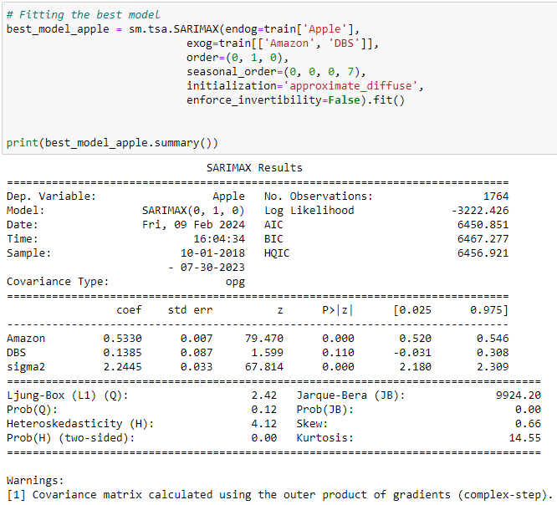
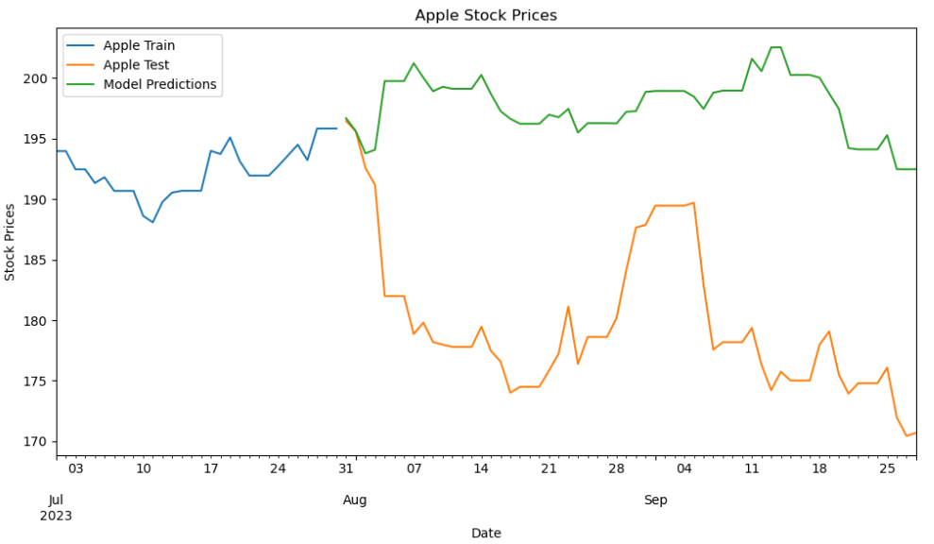
Apple
Model’s prediction:

Slide 15
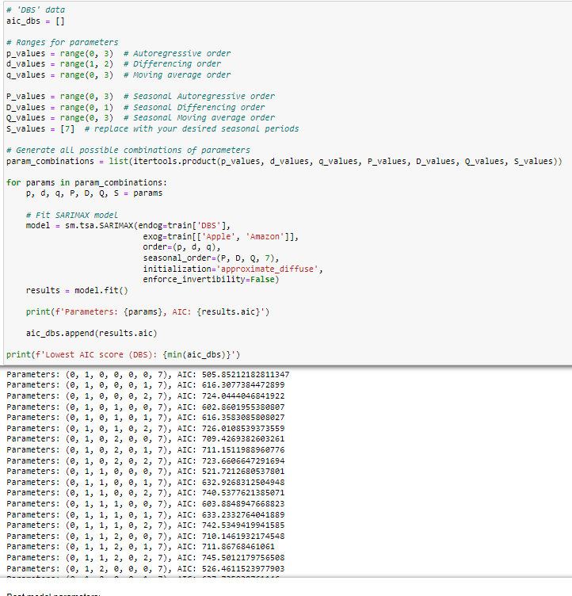
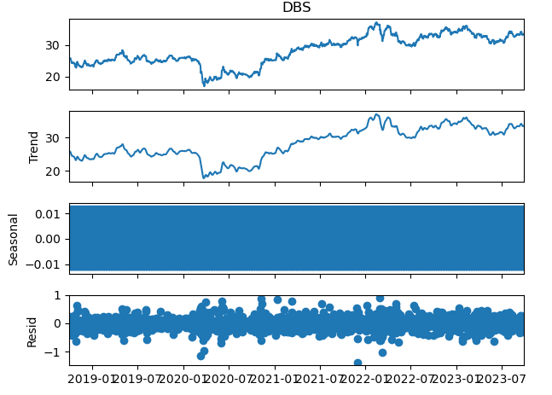
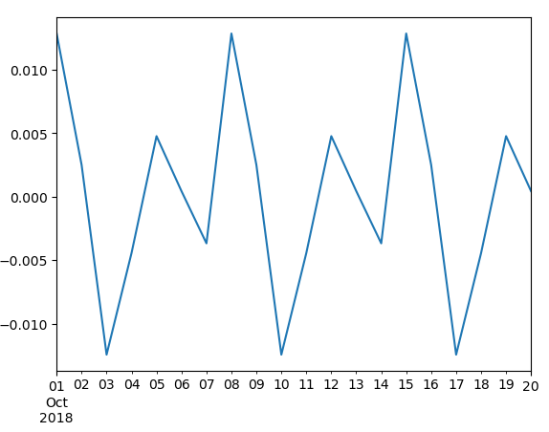

DBS
Tuning the hyperparameters of SARIMAX
After zooming into the seasonal plot, it can be identified there is a seasonal trend of 7 days.

Slide 16
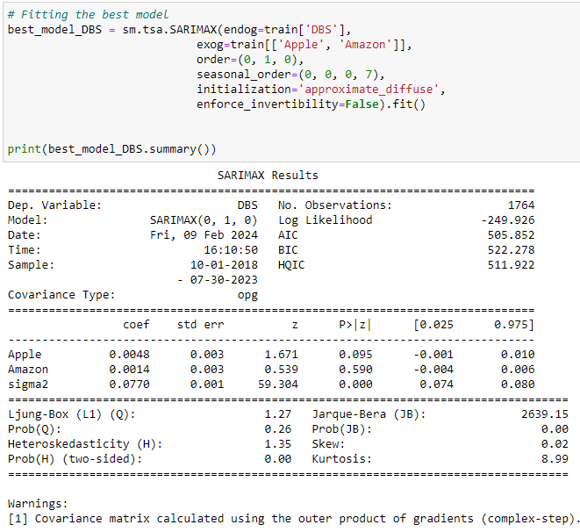
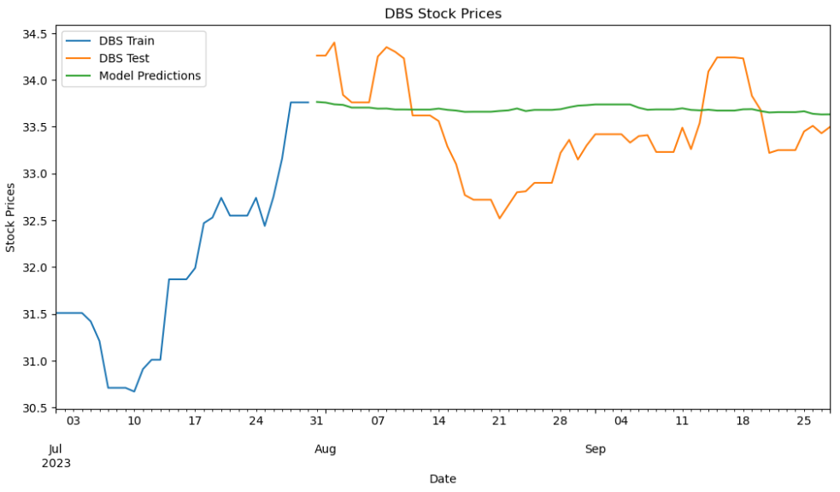
DBS
Model’s prediction:
There may be some issues with the modelling which caused the prediction to be a straight line

Slide 17



3. Evaluate
After finding the best models to fit the 3 stock prices, the models will be evaluated by their accuracy (e.g. MAPE, MSE, R2)
Amazon
Apple
DBS
Comparing the 3 stock prices with the best model parameters, the model performed when predicting the stock prices of DBS.
However, if we were to look at the shape of the predictions for DBS, the model predicted a close-to-straight line, which may not be a good thing when it comes to forecasting for the stock prices.

Slide 18
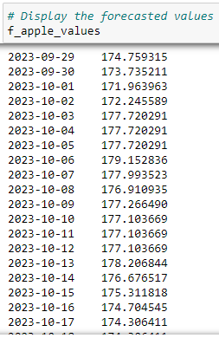
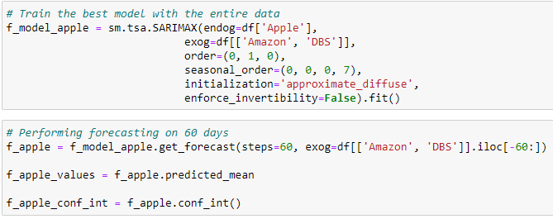
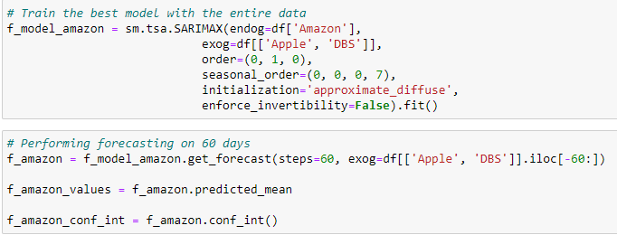
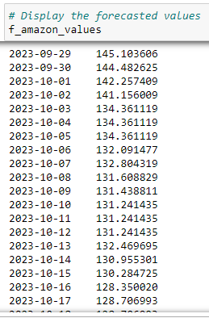
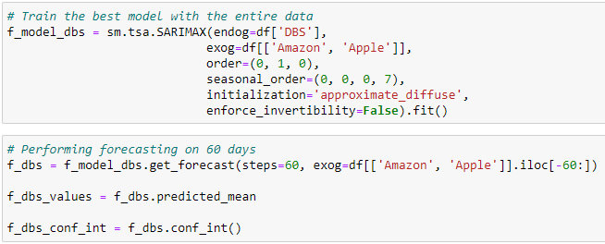
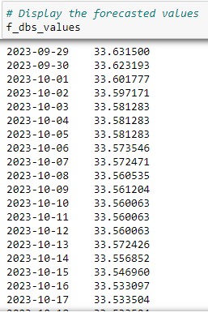
4. Forecasting
Forecasting
Apple Stock Prices
Forecasting
Amazon Stock Prices
Forecasting
DBS Stock Prices

Slide 19
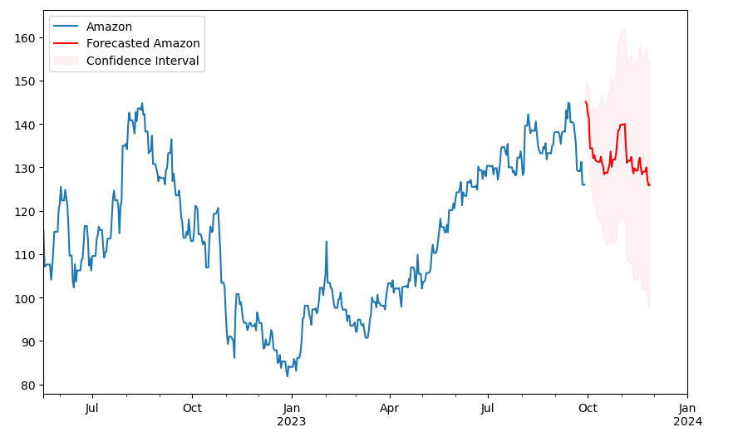
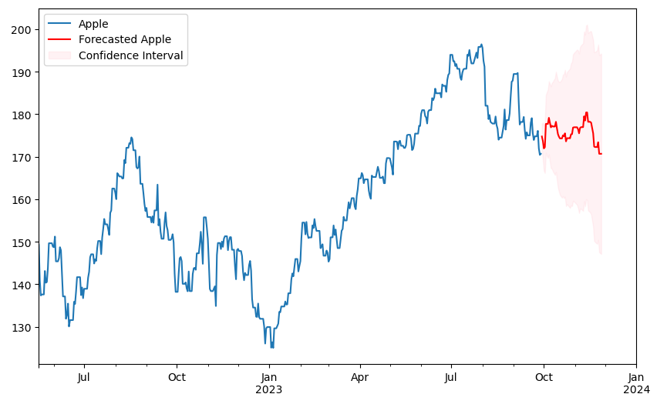
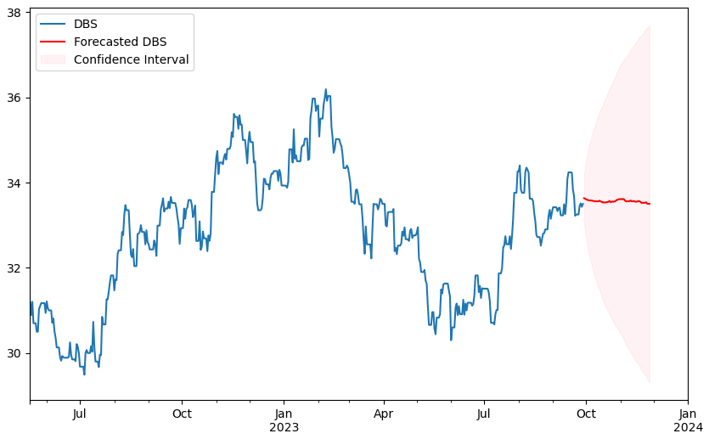
Plotting forecast
Displayed above are the forecasts for Amazon, Apple and DBS for the next 60 days
Reasons for the forecasting of DBS being a straight line may be due to a lack of trend from the data given. However, it may be due to a lack of tuning on the SARIMAX model

